Slide 1
Monitoring the earth from space
Technical Interchange Teleconference between NOAA, BOM and JMA
Himawari RGB Quick Guides and examining RGBs containing near-infrared imagery - heading towards more effective use of RGB composite imagery -
Meteorological Satellite Center
Japan Meteorological Agency
Akihiro SHIMIZU
The Tenth Asia-Oceania Meteorological Satellite Users’ Conference (AOMSUC-10)
Melbourne, Australia

Slide 2
Contents
Himawari RGB Quick Guides
Quick guide features
Background
Future plan
Examining RGBs containing near-infrared imagery
- based on Himawari RGB Quick Guide contents -
Fire Temperature RGB
Cloud Phase Distinction RGB
Summary

Slide 3
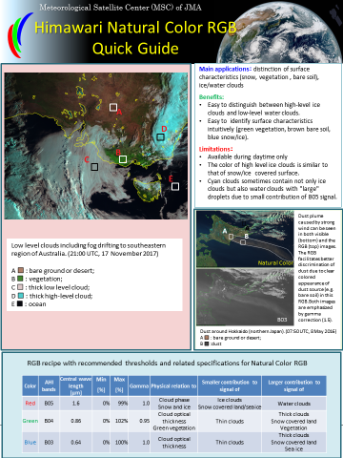
Himawari RGB Quick Guides

Slide 4
Quick Guide features What is RGB Quick Guide?
Simple material which summarizes how to use respective RGB composite imagery.
Quick Guides are composed of a pair of surface and reverse side (two-slides), therefore you can use them by inserting printed Quick Guides in plastic clear file folders.
The essential contents allow users to easily use in daily shift work.
The contents are as follows.
Main application(s), benefits and limitations
Typical cases
Color interpretation
RGB recipe (combinations of imagery assigned to the three primary colors with recommended thresholds) and related specifications
Himawari Quick Guides for RGB composites which are available on SATAID software (18 types) are in preparation.

Slide 5
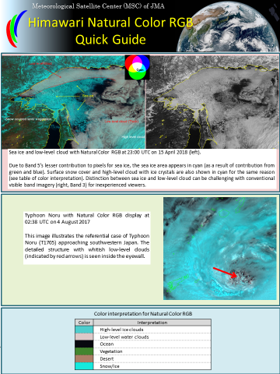
Appearance and structure of RGB Quick Guide
Typical cases and their explanations.
Typical case and its explanation.
Surface
Main application(s), benefits and limitations.
Reverse
Typical case and its explanation.
RGB recipe with recommended thresholds and related specifications.
Color interpretation.

Slide 6
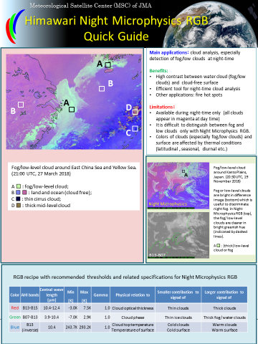
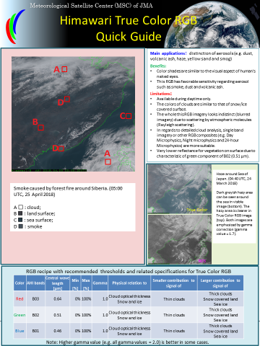
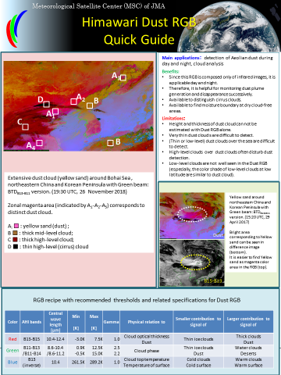
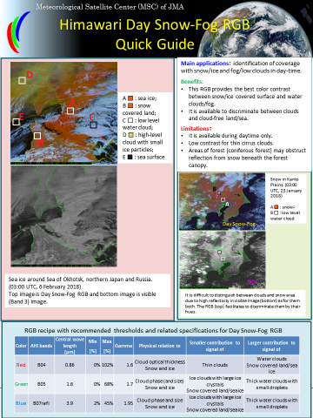
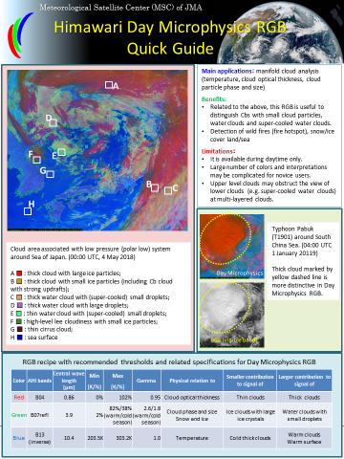
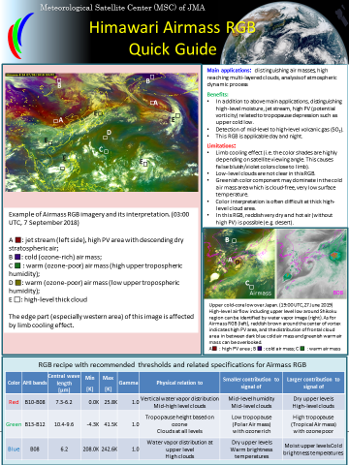
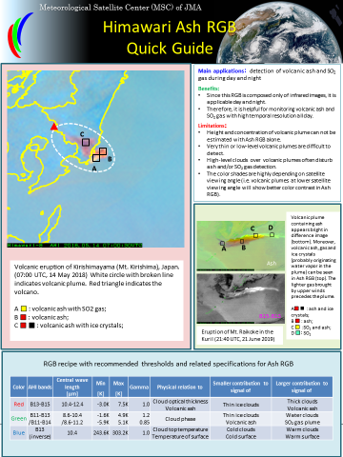
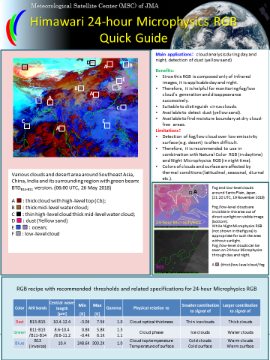
Himawari RGB Quick Guides for WMO Standard RGBs
Night Microphysics
Natural Colors
True Color
Dust
Day Snow-Fog
Day Microphysics
Airmass
Ash
24-hour Microphysics

Slide 7
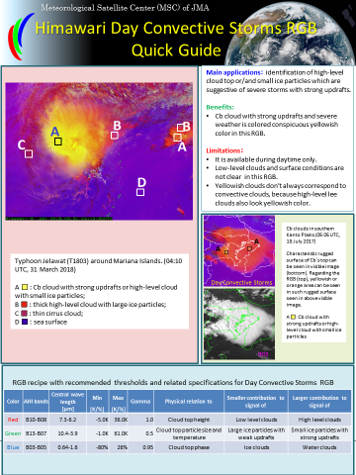
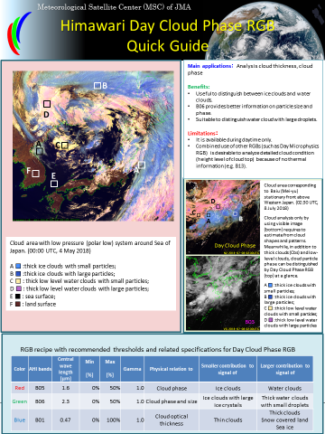
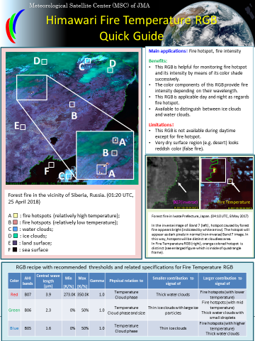
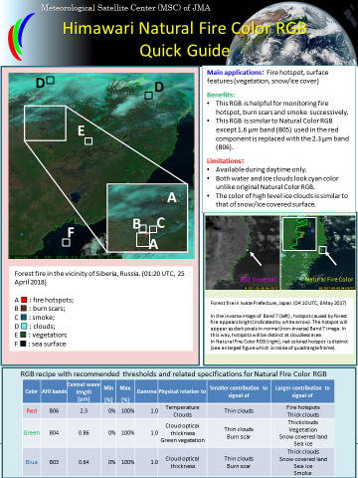
Himawari RGB Quick Guides for well-known RGBs and polar-orbit satellites origin RGBs
Day Convective Storms
Day Cloud Phase
Fire Temperature
Natural Fire Color

Slide 8
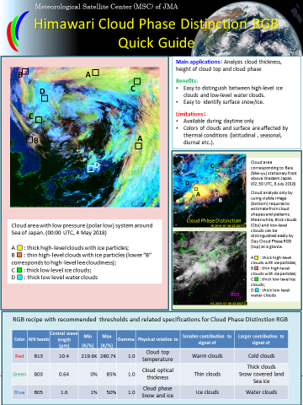
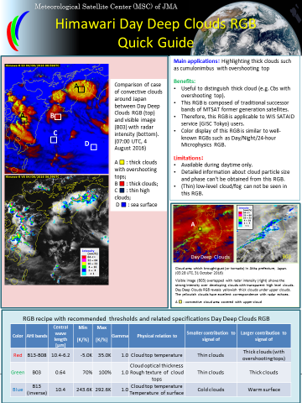
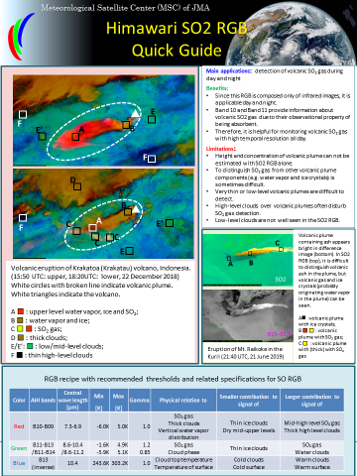
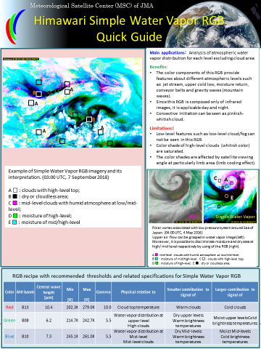
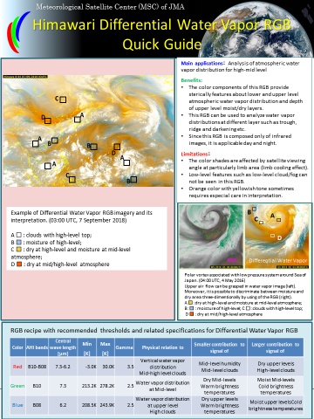
Himawari RGB Quick Guides for RGBs developed by JMA
Cloud Phase Distinction
Day Deep Clouds
SO2
Simple Water Vapor
Differential Water Vapor

Slide 9
Back ground
Use of RGB composite imagery has become widespread among Himawari image users.
There were requests from users to make simple, quick-look materials (including color interpretations and AHI band characteristics).
Other meteorological satellite training centers such as EUMeTrain and SPoRT (NOAA/NASA) have been already providing very useful “RGB Quick Guides”.
The Japanese language version have been created for JMA’s related staffs beforehand.
The contents are based on JMA’s “Meteorological Satellite Center Technical Note” written by A. Shimizu (the report will be available on the website in near future.) and existing Quick Guides of EUMeTrain and SPoRT.

Slide 10
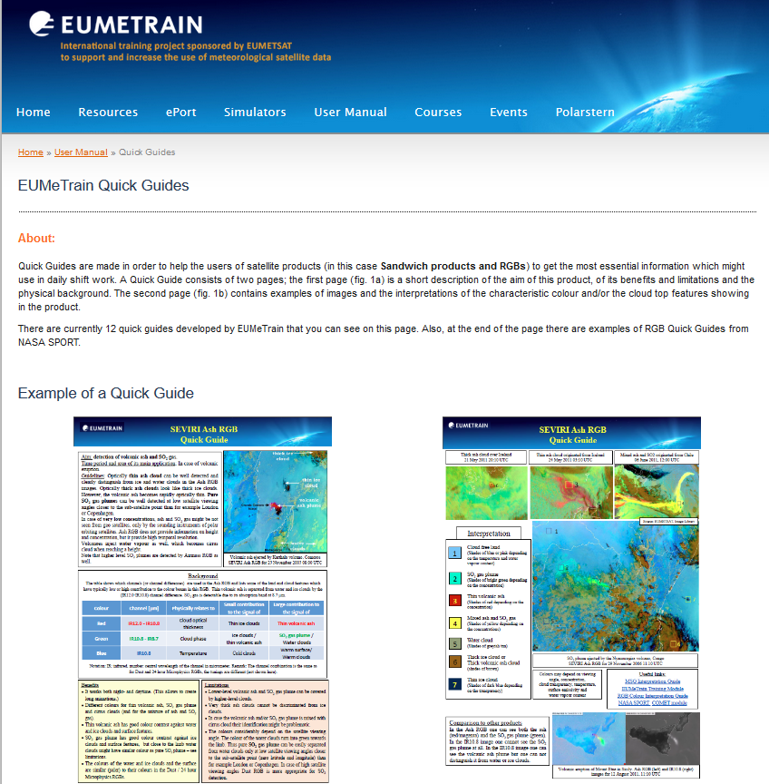
Reference: RGB Quick Guide by EUMeTrain
RGB Quick Guides for Meteosat (MSG) users.
Good references for making Himawari version.
http://eumetrain.org/rgb_quick_guides/index.html

Slide 11
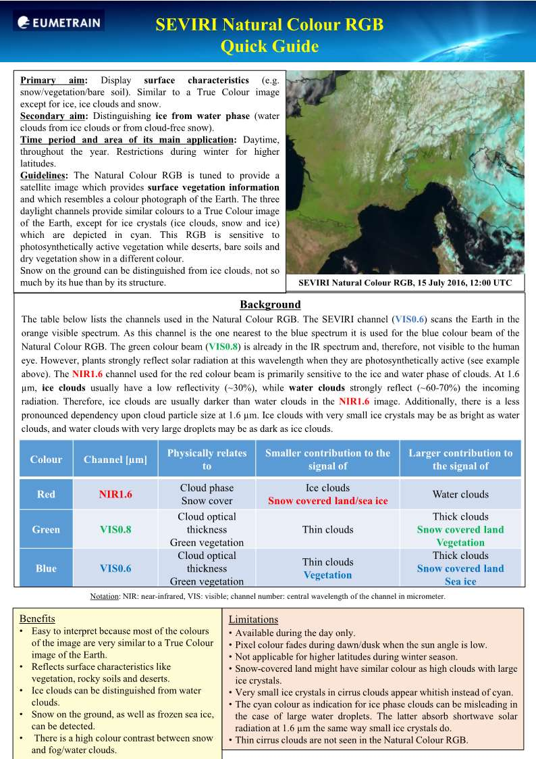
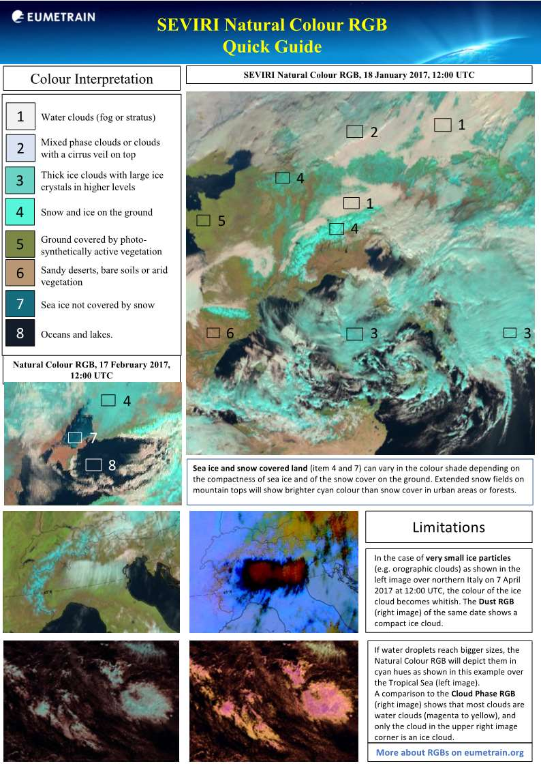
Reference: Natural Colour RGB Quick Guide by EUMeTrain
http://eumetrain.org/rgb_quick_guides/index.html

Slide 12
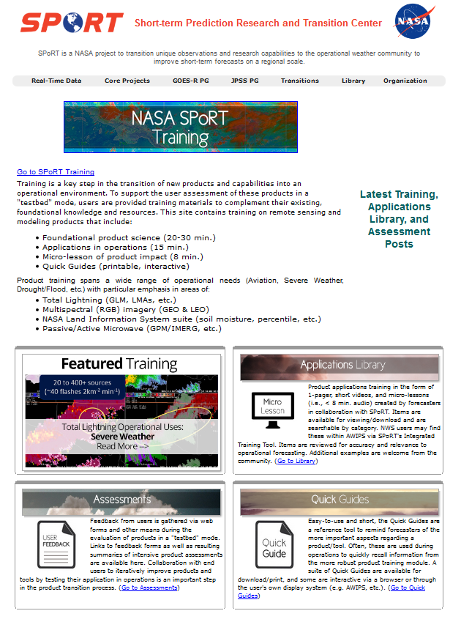
Reference: RGB Quick Guide by NASA SPoRT
RGB Quick Guides for GOES users.
Some Himawari versions are also available!
https://nasasporttraining.wordpress.com/quick-guides/

Slide 13
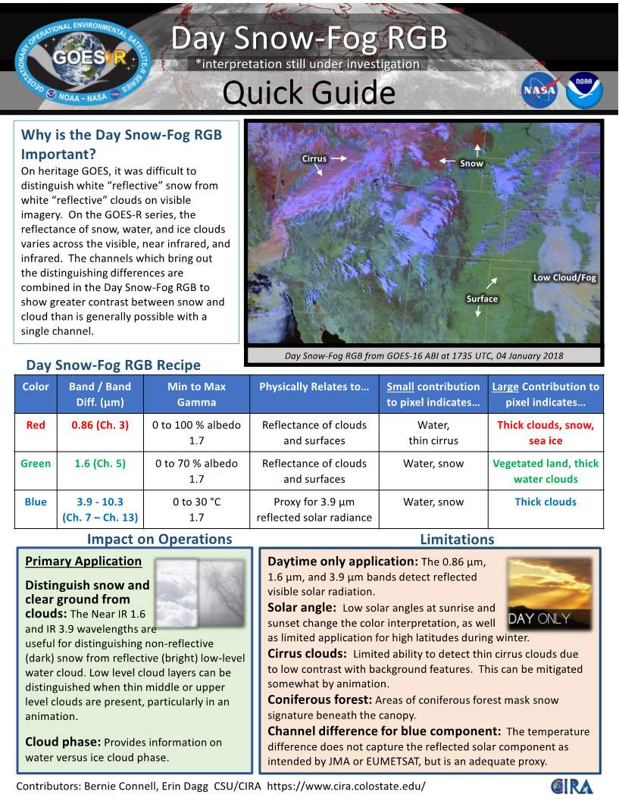
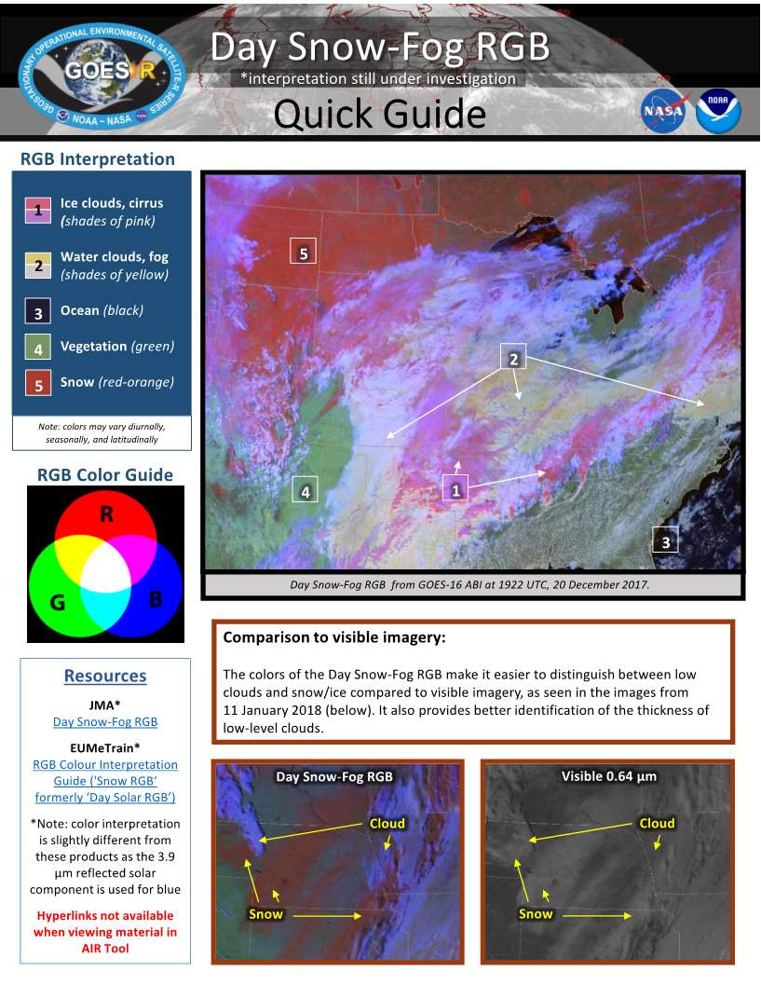
Reference: Day Snow-Fog RGB Quick Guide by SPoRT

Slide 14
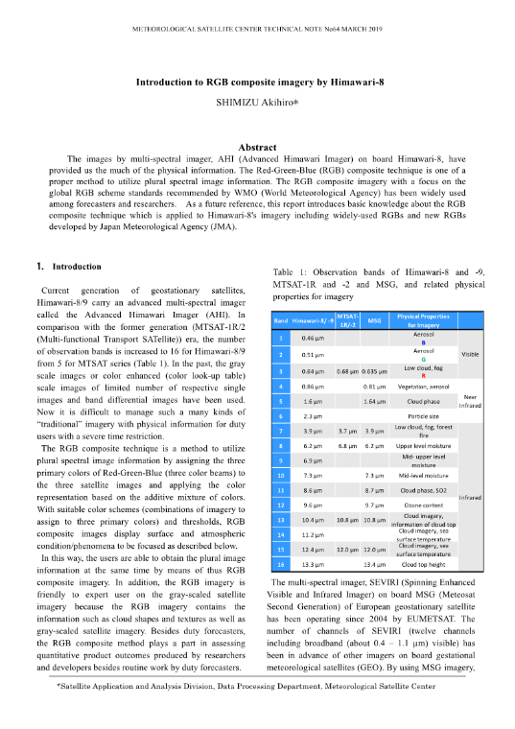
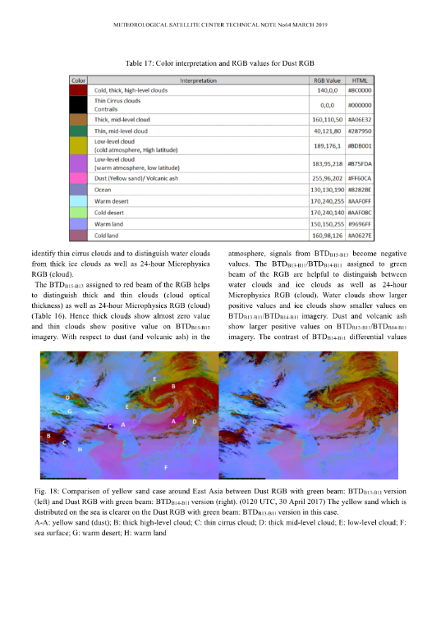
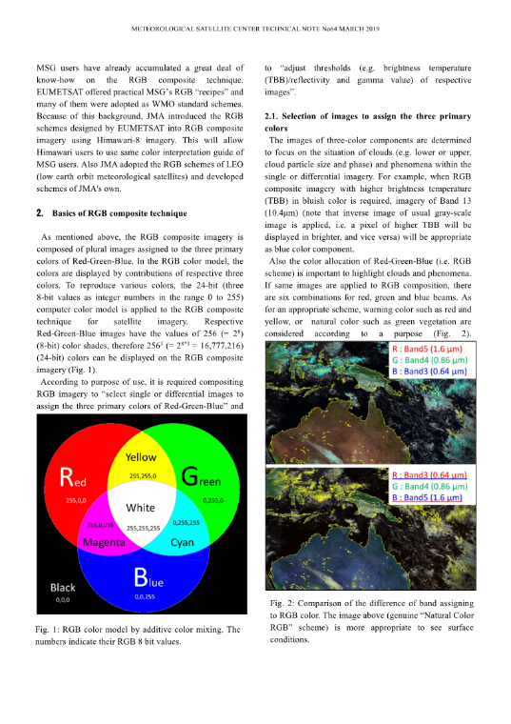
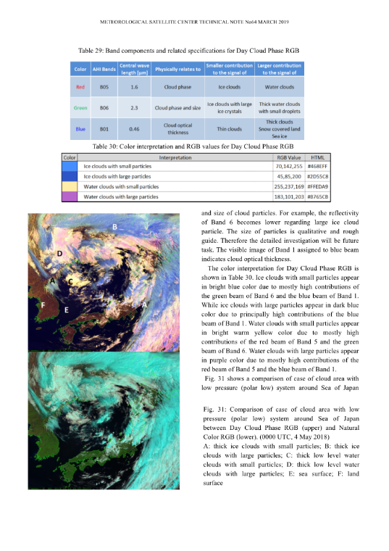
JMA’s Meteorological Satellite Center Technical Note “Introduction to RGB composite imagery by Himawari-8” (A. Shimizu)
The report will be available on the website in near future.

Slide 15
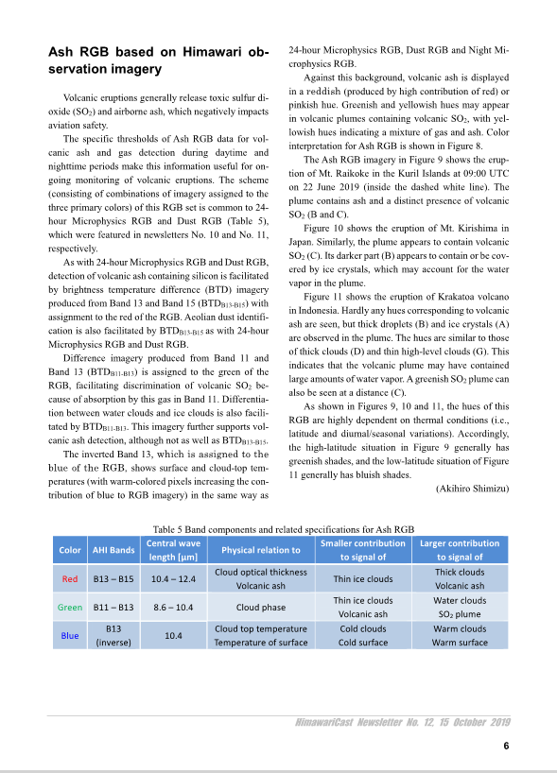
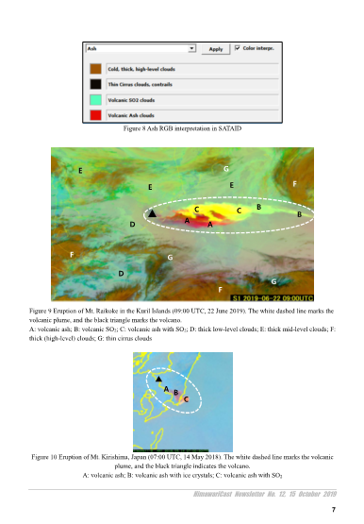
Reference: HimawariCast Newsletter
HimawariCast Newsletters have been established in consideration of the current situation to enable sharing of important information and expertise on satellite imagery analysis.
Their contents include important information relating to the operation of HimawariCast receiving systems, examples of satellite imagery analysis techniques and tips on using JMA’s SATAID display and analysis program.
There are serialized article on RGB composites!
https://www.data.jma.go.jp/mscweb/en/himawari89/himawari_cast/himawari_cast.php

Slide 16
Future plan
Currently, the details of the contents are being examined.
There is a plan to publish the Himawari RGB Quick Guides on the Meteorological Satellite Center/JMA website.
The detailed report related to the RGB composite introduction will be also published on the website.
Additional quick guide for other useful imagery products (e.g. sandwich product) will be considered in the future.

Slide 17
Examining RGBs containing near-infrared imagery - based on Himawari RGB Quick Guide contents - Fire Temperature RGB Cloud Phase Distinction RGB

Slide 18
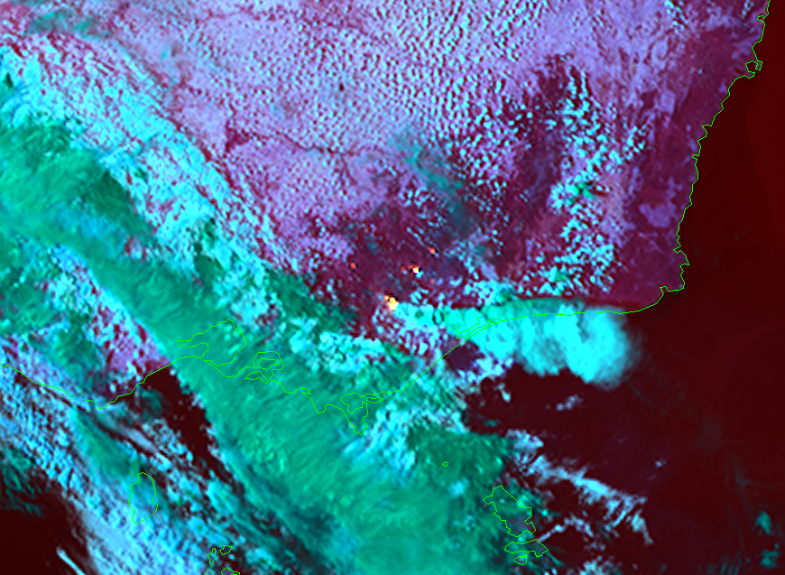
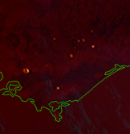
Fire Temperature RGB
(Right) Large scale fires in Victoria, Australia. (05:30 UTC, 3 March 2019)
Cloud marked “B” corresponds to fire cloud (including pyrocumulus cloud) caused by bush fire (marked “A”).
(Bottom) Fire hotspots before daylight time (20:00 UTC, 2 March 2019)
D
D
A
A
C
B
B
E
A ■ ■ : fire hotspots;
B ■ : fire clouds (pyrocumulus cloud) with ice droplets;
C ■: ice clouds;
D ■ : water clouds;
E ■ : sea surface
A
A
A
C
A
D
A
RGB recipe with recommended thresholds and related specifications for Fire Temperature RGB
Color | AHI bands | Central wave length [μm] | Min | Max | Gamma | Physical relation to | Smaller contribution to signal of | Larger contribution to signal of
 |  |  | [K/%] | [K/%]
Red | B07 | 3.9 | 273.0K | 350.0K | 1.0 | Temperature Cloud phase | Thick water clouds | Fire hotspots (with lower temperature)
Green | B06 | 2.3 | 0% | 50% | 1.0 | Temperature Cloud phase and size | Thin ice clouds with large ice particles | Fire hotspots (with mid temperature) Thick water clouds with small droplets
Blue | B05 | 1.6 | 0% | 50% | 1.0 | Temperature Cloud phase | Thin ice clouds | Fire hotspots (with higher temperature) Thick water clouds
Color interpretation for Fire Temperature RGB
Color | Interpretation
 | Low temperature hotspots
 | Medium temperature hotspots
 | High temperature hotspots
 | Water clouds
 | Ice clouds

Slide 19
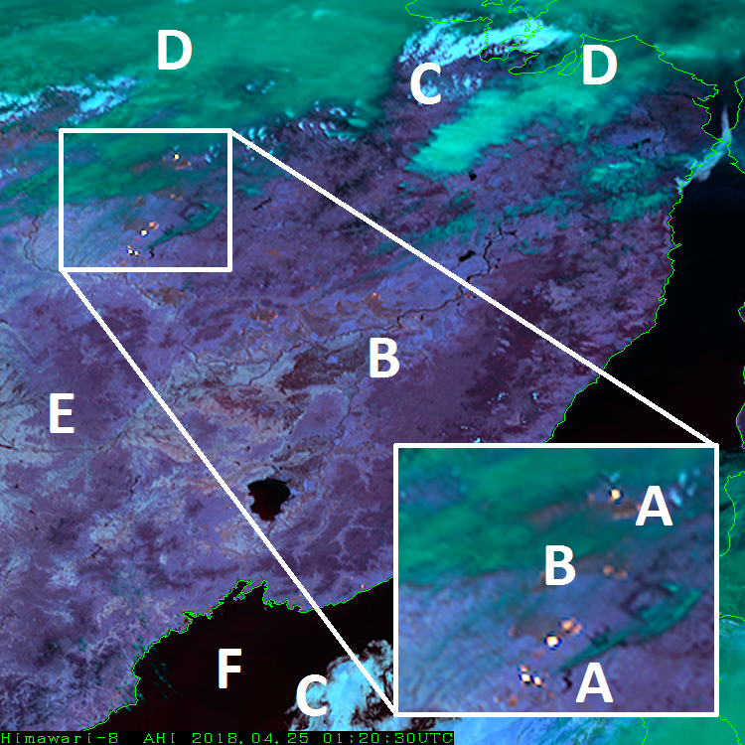
Fire Temperature RGB
Main applications： Fire hotspot, fire intensity
Benefits:
This RGB is helpful for monitoring fire hotspot and its intensity by means of its color shade successively.
The color components of this RGB provide fire intensity depending on their wavelength.
This RGB is applicable day and night as regards fire hotspot.
Available to distinguish between ice clouds and water clouds.
Limitations：
This RGB is not available during daytime except for fire hotspot.
Very dry surface region (e.g. desert) looks reddish color (false fire).
Forest fire in the vicinity of Siberia, Russia. (01:20 UTC, 25 April 2018)
A ■ : fire hotspots (relatively high temperature);
B ■ : fire hotspots (relatively low temperature);
C ■ : water clouds;
D ■ : ice clouds;
E ■ : land surface;
F ■ : sea surface

Slide 20
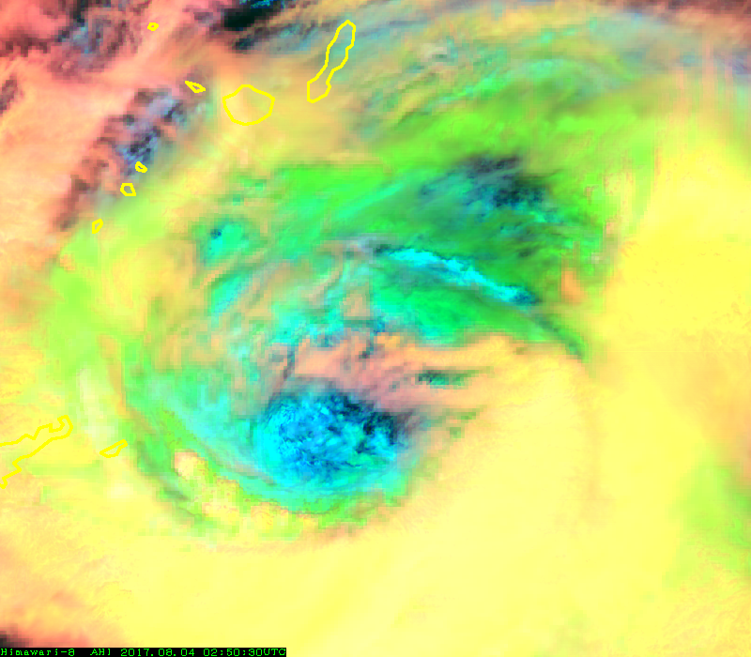
Cloud Phase Distinction RGB
B
Typhoon (Noru) by Cloud Phase Distinction RGB. (02:50UTC, 4 August 2017)
The detailed structure consisting of blueish low level clouds (marked “D”) can be seen inside eyewall.
A ■ : thick high-level clouds with ice particles;
B ■ : thin high-level clouds with ice particles;
C ■ : thick low level ice clouds;
D ■ : thick low level water clouds
C
A
B
C
A
D
A
RGB recipe with recommended thresholds and related specifications for Cloud Phase Distinction RGB
Color interpretation for Cloud Phase Distinction RGB
Color | AHI bands | Central wave length [μm] | Min | Max | Gamma | Physical relation to | Smaller contribution to signal of | Larger contribution to signal of
 |  |  | [K/%] | [K/%]
Red | B13 | 10.4 | 219.6K | 280.7K | 1.0 | Cloud top temperature | Warm clouds | Cold clouds
Green | B03 | 0.64 | 0% | 85% | 1.0 | Cloud optical thickness | Thin clouds | Thick clouds Snow covered land Sea ice
Blue | B05 | 1.6 | 1% | 50% | 1.0 | Cloud phase Snow and ice | Ice clouds | Water clouds
Color | Interpretation
 | Thick high level clouds with ice particles, Cb
 | Thin high level clouds with ice particles
 | Thick low level ice clouds Snow/ice covered area
 | Thick low level water clouds

Slide 21
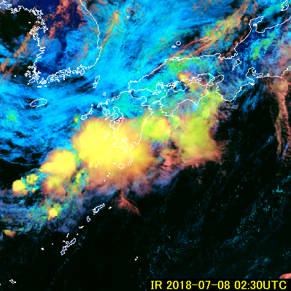
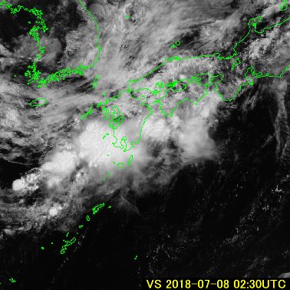
Cloud Phase Distinction RGB
Main applications： Analysis cloud thickness, height of cloud top and cloud phase
Benefits:
Easy to distinguish between high-level ice clouds and low-level water clouds.
Easy to identify surface snow/ice.
Limitations：
Available during daytime only
Colors of clouds and surface are affected by thermal conditions (latitudinal , seasonal, diurnal etc.).
C
D
A
Cloud area corresponding to Baiu (Mei-yu) stationary front above Western Japan. (02:30 UTC, 8 July 2018)
Cloud analysis only by using visible image (bottom) requires to estimate from cloud shapes and patterns. Meanwhile, thick clouds (Cbs) and low-level clouds can be distinguished easily by Day Cloud Phase RGB (top) at a glance.
A ■ : thick high-level clouds with ice particles;
B ■ : thin high-level clouds with ice particles;
C ■ : thick low level ice clouds;
D ■ : thick low level water clouds
B
Cloud Phase Distinction
B03

Slide 22
Summary
JMA is planning to provide RGB Quick Guides to Himawari imagery users on JMA/MSC website.
The detailed report related to the RGB composite introduction will be also published on the website.
The RGB composites which are not so familiar to users (e.g. RGBs developed by JMA) are also useful.
As examples of such RGBs, “Fire Temperature RGB” and “Cloud Phase Distinction RGB” were introduced by using Himawari RGB Quick Guide contents.

Slide 23
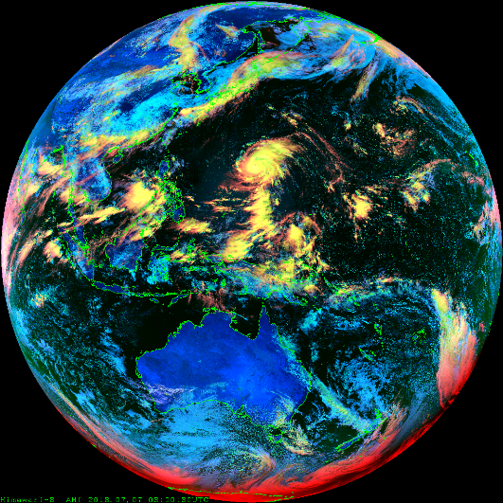
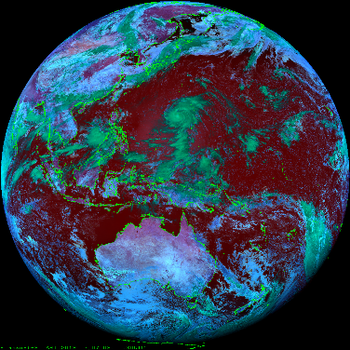
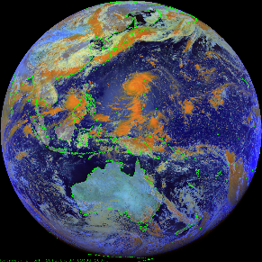
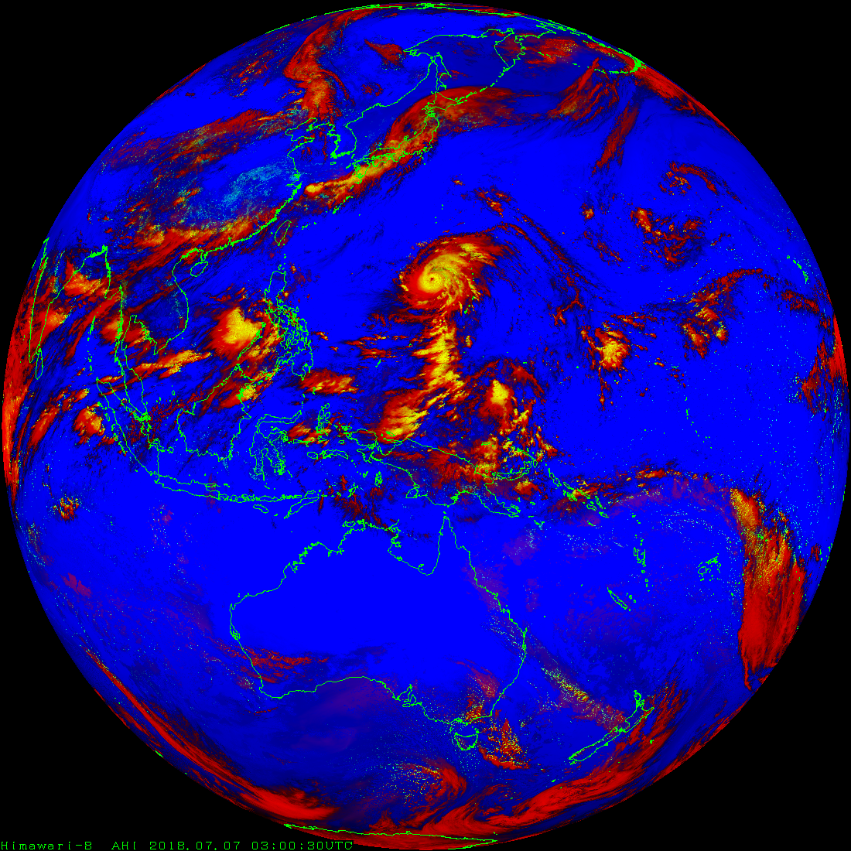
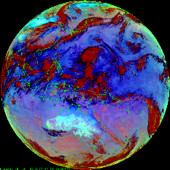
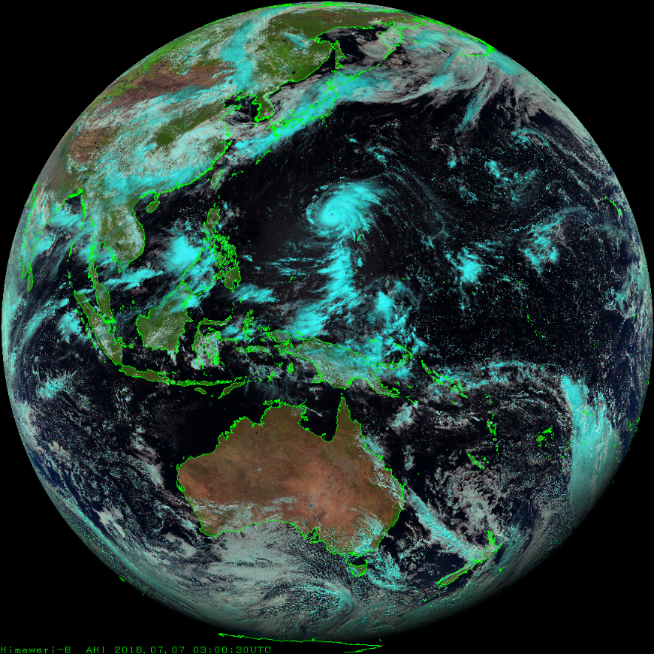
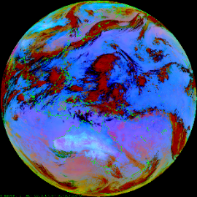
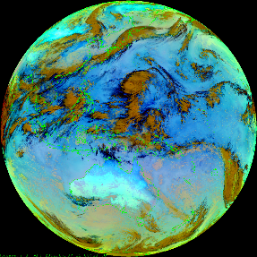
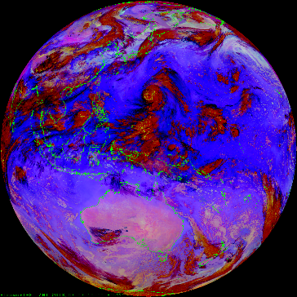
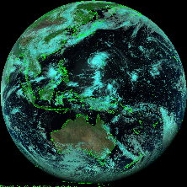
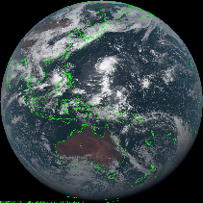
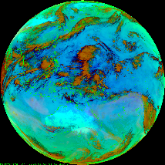
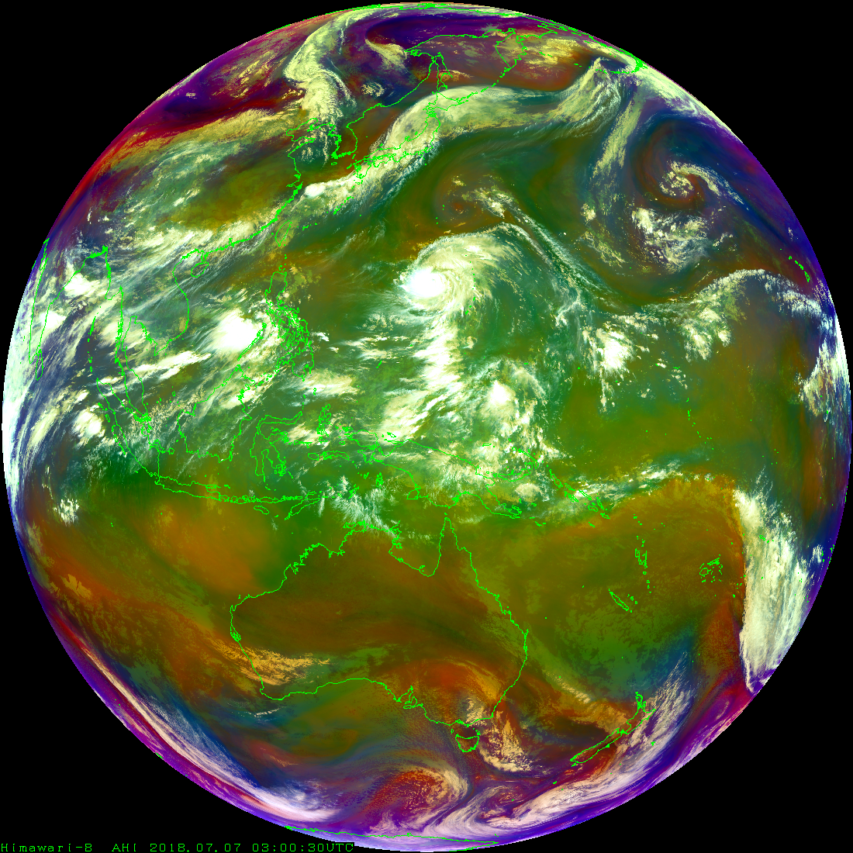
Thank you !

Slide 24
Samples of Himawari RGB Quick Guides
24hourMicrophysics
Airmass
Natural Color
Cloud Phase Distinction
Fire Temperature
Day Deep Clouds

